Slide 1
Physics-Constrained Procedural Generation of Synthetic Environments - For the Robust Validation of Autonomous Maneuver and Logistics
Bulent Soykan, Ghaith Rabadi, Grace Bochenek, and Victor J. Paul
DISTRIBUTION STATEMENT A.
Approved for public release; distribution is unlimited. OPSEC#: 10946
Notes:
Good morning. My name is Bulent Soykan. Today, I am presenting our work on physics-constrained procedural environments. We built this framework to improve how we validate autonomous maneuver and logistics systems. I want to thank my co-authors Ghaith Rabadi, Grace Bochenek, and Victor J. Paul for their contributions to this research.

Slide 2
Outline
Introduction & Motivation
System Architecture
Terrain Intelligence & Constraints
Logistics Constraint Modeling
VV&A and The Digital Twin Methodology
Experimental Results
Conclusion & Future Work
Notes:
Here is a brief look at our agenda. I will start by defining the gap in current autonomy validation. Then, I will walk through our system architecture, focusing on how we model terrain and logistics constraints. Finally, I will share our experimental results and our approach to system accreditation.

Slide 3
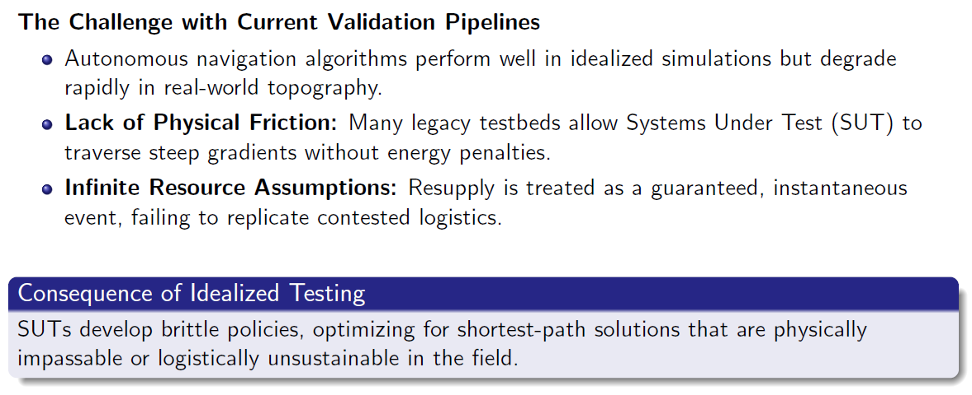
The ”Sim-to-Real” Gap in Autonomy Validation
Notes:
We have a problem in how we test autonomous systems. Algorithms often perform flawlessly in simulations but fail in the field. This happens because our simulations are too forgiving. Many testbeds lack physical friction. They allow vehicles to drive up steep hills without energy penalties. They also assume resupply is guaranteed and instant. Because of this, autonomous systems learn brittle policies. They optimize for the shortest geometric path, which is often physically impassable or logistically impossible in the real world.

Slide 4
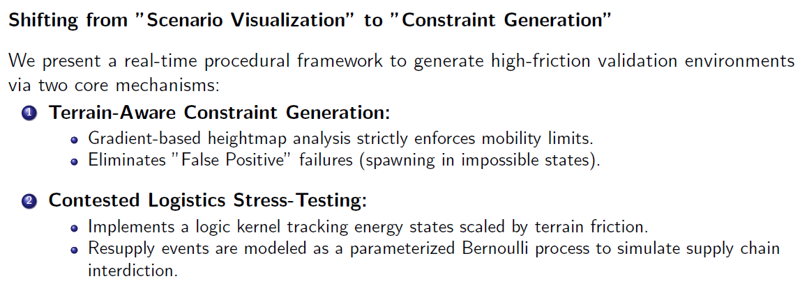
Objectives of the Proposed Framework
Notes:
To fix this, we need to shift our focus. We must move away from just visualizing scenarios and move toward generating strict constraints. Our framework does this through two core mechanisms. First, we use terrain-aware constraint generation. We analyze heightmaps to enforce strict mobility limits. This stops the simulation from spawning vehicles in impossible states. Second, we use contested logistics stress-testing. We track energy states based on terrain friction and use probability to simulate supply chain failures.

Slide 5
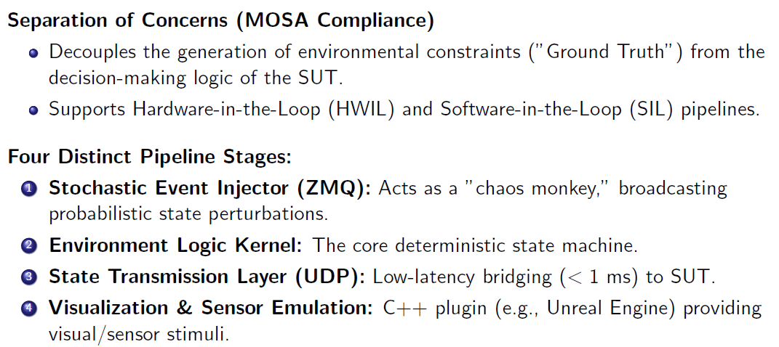
Modular Testbed Architecture
Notes:
We built the testbed with a modular architecture. We completely separate the environmental ground truth from the decision-making logic of the system under test. This supports both software and hardware-in-the-loop pipelines. The pipeline has four stages. A stochastic event injector introduces random variables like weather or threat updates. The logic kernel enforces the physical rules. A low-latency UDP layer handles data transmission. Finally, a C++ plugin manages the visual and sensor emulation in the game engine.

Slide 6
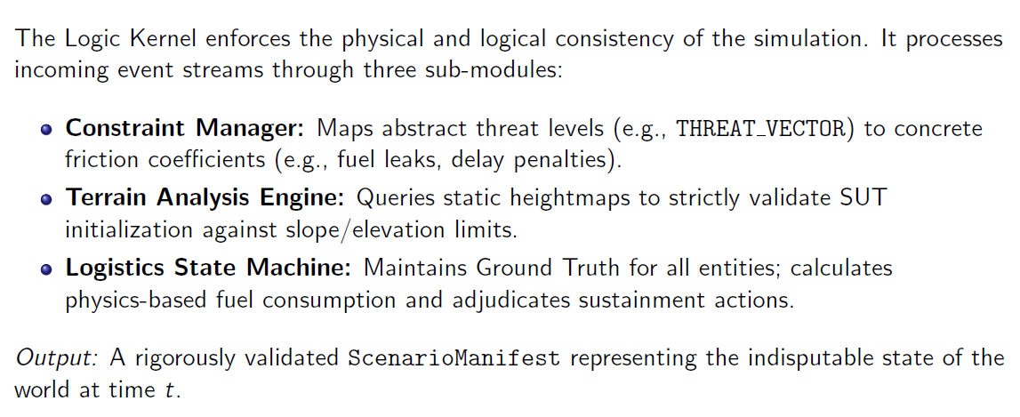
Environment Logic Kernel
Notes:
The logic kernel is the brain of our testbed. It ensures physical and logical consistency. It uses three sub-modules. The constraint manager translates abstract threats into concrete penalties, like fuel leaks. The terrain analysis engine checks the map to ensure the autonomous vehicle starts in a valid location. The logistics state machine tracks the true fuel and ammo levels of every entity. The output is a validated scenario manifest. This manifest is the indisputable state of the world.

Slide 7
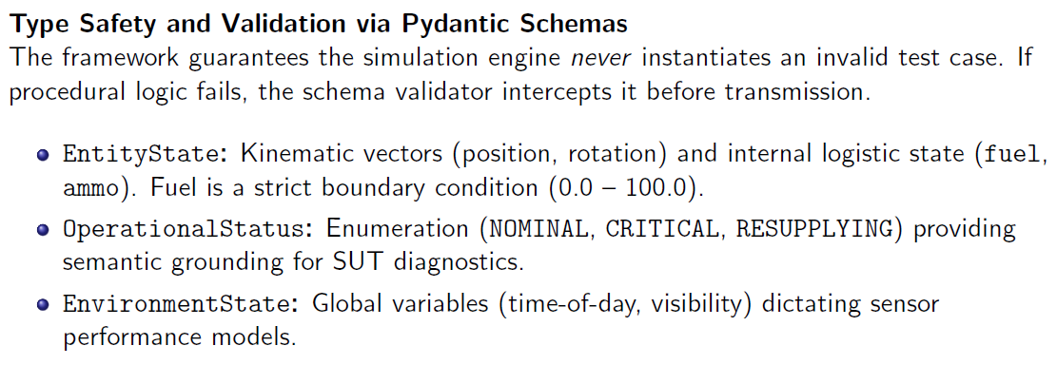
Interface Control and Data Contracts
Notes:
We use strict data schemas to guarantee type safety between our Python kernel and the C++ engine. If our procedural logic fails and generates an impossible test case, the schema validator intercepts it before it reaches the simulation. We define exact structures for kinematic vectors, operational status, and environmental variables. Fuel, for example, is a strict boundary condition bound between zero and one hundred.

Slide 8
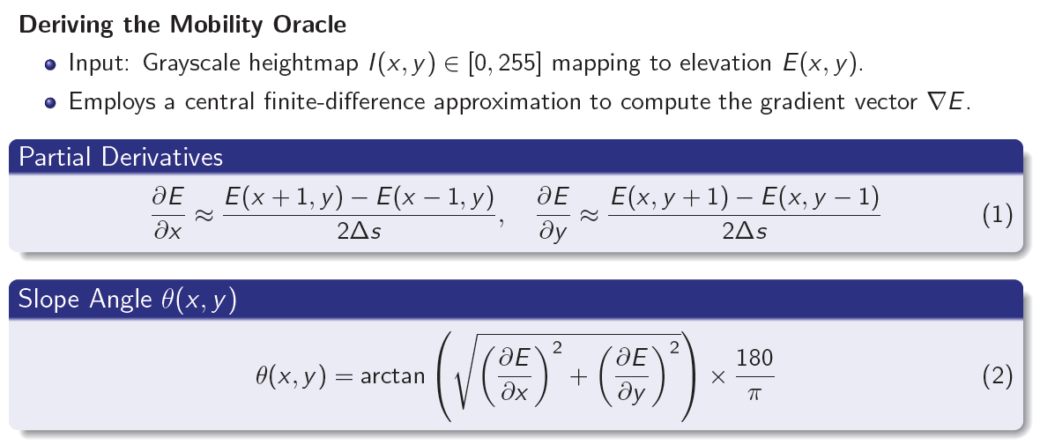
Terrain Analysis: Gradient-Based ODD Definition
Notes:
To define the Operational Design Domain, we need a mobility oracle. We start with a grayscale heightmap. We use a central finite-difference approximation to compute the gradient vector of the elevation field. The equations on screen show how we calculate the partial derivatives to find the exact slope angle at any given coordinate. This gives us the mathematical ground truth for what the vehicle can and cannot traverse.

Slide 9
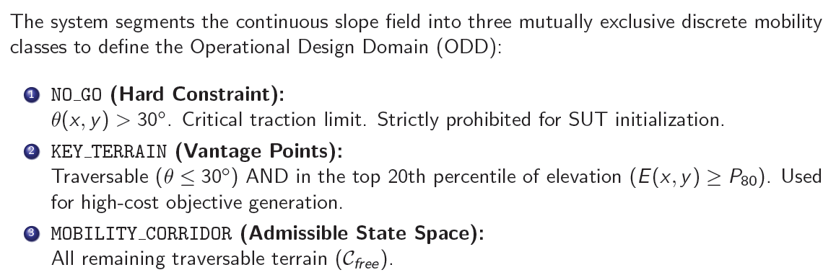
Semantic Mobility Classification
Notes:
Once we have the slope data, we divide the map into three distinct zones. The first is "NO GO" terrain. For our tests, this is any slope over 30 degrees. This is a hard constraint where the vehicle cannot go. The second is "KEY TERRAIN." These are areas that are traversable but sit in the top 20 percent of elevation. We use these for generating high-cost navigation goals. The third is the "MOBILITY CORRIDOR." This is the remaining flat, traversable terrain where standard maneuver occurs.

Slide 10
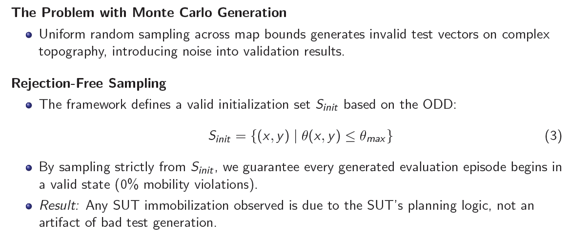
Valid-by-Construction Initialization
Notes:
Many current test setups use uniform random sampling to place vehicles on a map. On complex terrain, this generates invalid test vectors and introduces noise into the results. We use a method called rejection-free sampling. We define a valid initialization set based strictly on the vehicle's slope limits. By sampling only from this set, we guarantee that every evaluation episode begins in a valid state. If the vehicle gets stuck later, we know it was a failure in the autonomous planning logic, not a bad spawn point.

Slide 11
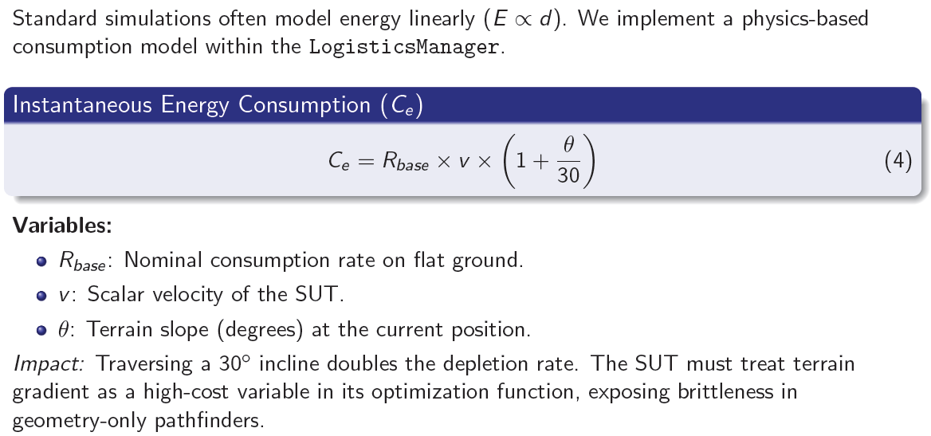
Terrain-Coupled Energy Expenditure
Notes:
Standard simulations often calculate energy drain purely based on distance. We implemented a physics-based model instead. Our formula scales the base consumption rate by the velocity and the terrain slope. Driving up a 30-degree incline doubles the rate of energy depletion. The autonomous planner must now treat the terrain gradient as a high-cost variable. This exposes flaws in pathfinders that only look at geometry.

Slide 12
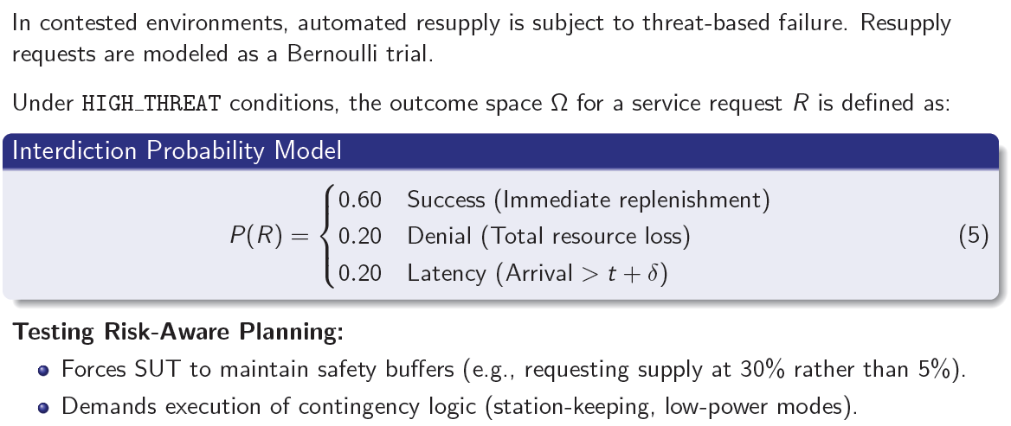
Stochastic Service Availability (Contested Logistics)
Notes:
In contested environments, automated resupply will sometimes fail. We model these requests as a Bernoulli trial. Under high-threat conditions, a request has a 60 percent chance of immediate success. It has a 20 percent chance of total failure, and a 20 percent chance of being delayed. This forces the autonomous system to maintain safety buffers. It cannot wait until it has 5 percent fuel to request support. It must also be capable of executing contingency logic, like entering a low-power state while waiting for a delayed supply delivery.

Slide 13
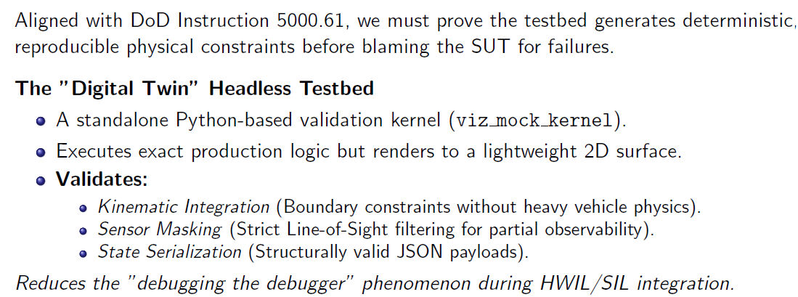
Verification, Validation, and Accreditation (VV&A)
Notes:
Before we can blame the autonomous system for a failure, we must prove our testbed is fair and deterministic. We follow DoD guidelines for validation. To do this, we built a "Digital Twin" headless testbed. It is a Python-based kernel that runs our exact production logic but renders to a simple 2D surface. This allows us to verify boundary constraints and line-of-sight masking without the overhead of heavy vehicle physics. It severely reduces debugging time.

Slide 14
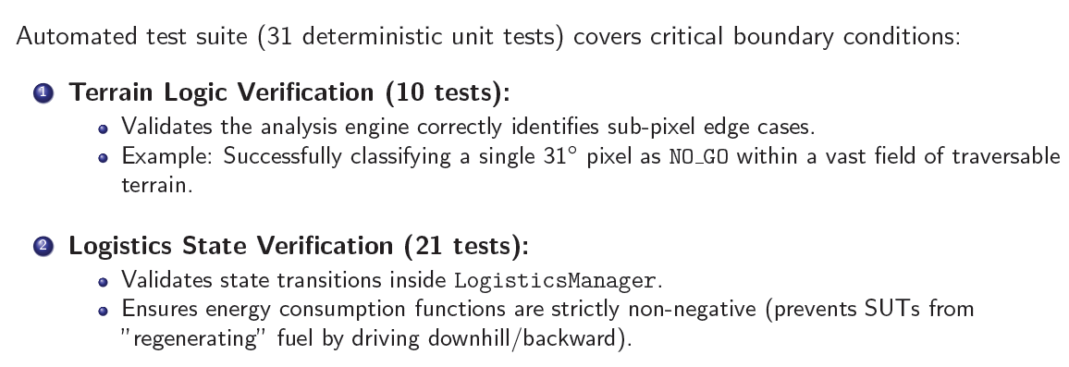
Code Verification
Notes:
We also wrote an automated suite of 31 deterministic unit tests. Ten of these tests focus on terrain logic. They verify that our engine can correctly identify sub-pixel edge cases, like a single steep pixel hidden in a flat field. The other 21 tests focus on logistics. They ensure that energy consumption is strictly non-negative. This prevents a common simulation exploit where a vehicle might "regenerate" fuel by driving downhill or backward.

Slide 15
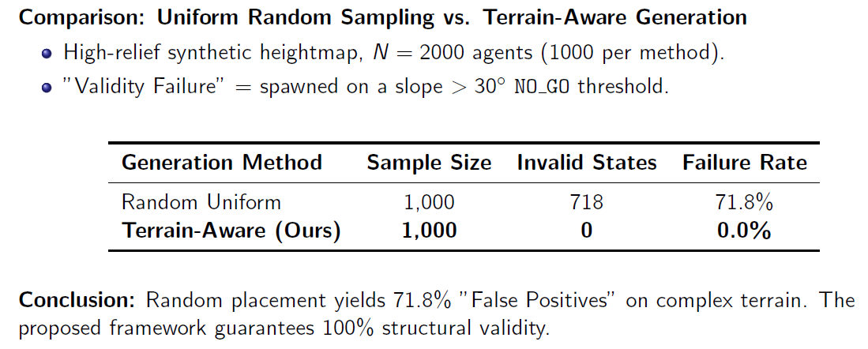
Experiment A: ODD Definition Viability
Notes:
We ran two experiments to prove our framework's utility. In Experiment A, we placed two thousand agents on a high-relief map. One thousand used random sampling, and one thousand used our terrain-aware generation. Random placement resulted in a 71.8 percent failure rate. This means over 70 percent of those test cases would have yielded false positives. Our framework achieved a zero percent failure rate.

Slide 16
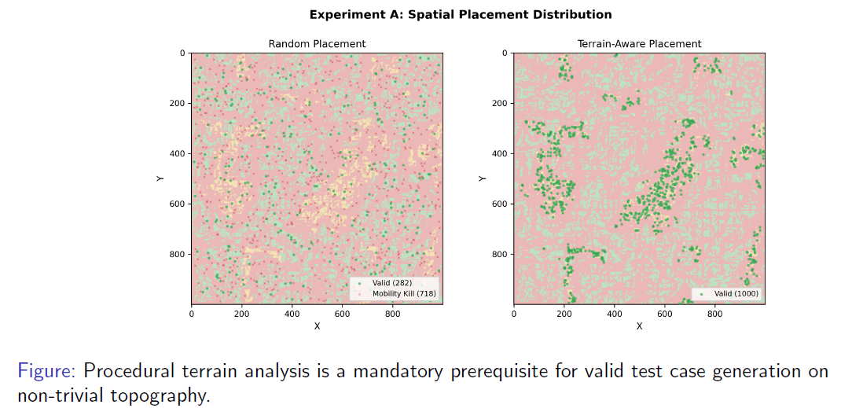
Visualizing Terrain-Aware Constraint Generation
Notes:
This slide visualizes the results of Experiment A. On the left, you see random placement. The red marks indicate agents spawned on impassable terrain. The test data here is mostly useless. On the right, you see our terrain-aware placement. The agents are strictly confined to valid corridors and key terrain features. This proves procedural terrain analysis is a mandatory first step for valid testing.

Slide 17
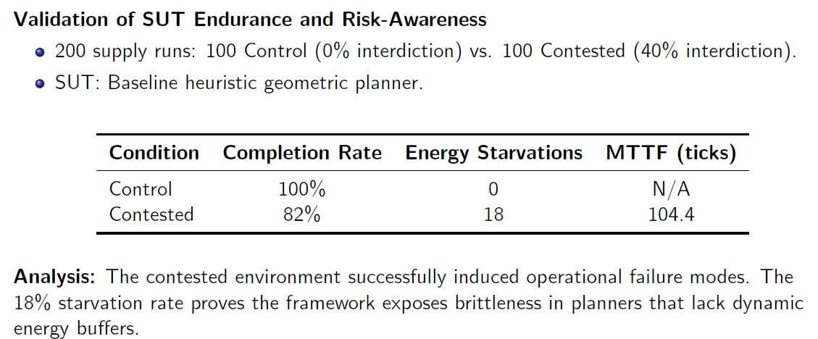
Experiment B: Logistics Stress-Testing
Notes:
In Experiment B, we tested logistics endurance using a baseline autonomous planner. We ran 100 supply routes under permissive conditions with zero interdiction. We ran another 100 routes under contested conditions with 40 percent interdiction. In the contested environment, mission completion dropped to 82 percent. Eighteen vehicles suffered total energy starvation. This proves our framework successfully induces operational failure modes and exposes brittleness in planners that lack dynamic energy buffers.

Slide 18
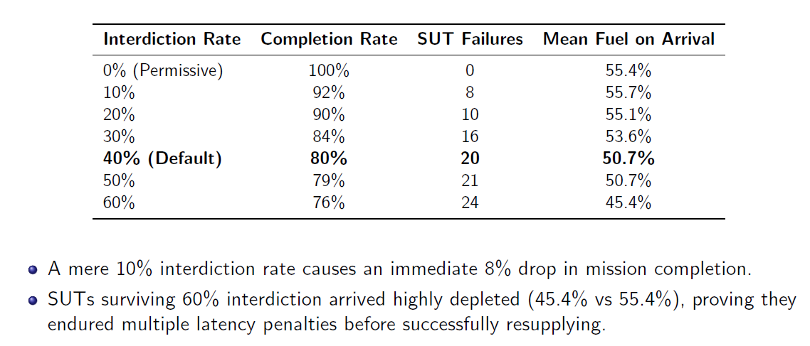
Sensitivity Analysis: Interdiction vs. SUT Fragility
Notes:
We then ran a sensitivity analysis across different interdiction rates. The data shows that even a small 10 percent chance of supply failure causes an immediate 8 percent drop in mission completion. Furthermore, agents that survived a 60 percent interdiction rate arrived with significantly depleted fuel reserves. They had to endure multiple delay penalties to finish the mission.

Slide 19
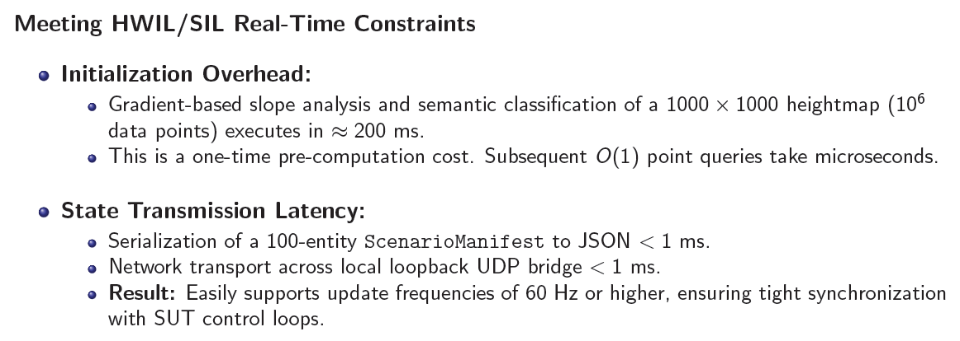
Testbed Performance and Latency Budgets
Notes:
To be useful for hardware-in-the-loop testing, the system must be fast. Our gradient-based slope analysis processes one million data points in about 200 milliseconds. This is a one-time cost at initialization. After that, point queries take microseconds. Our state transmission is also highly efficient. Serializing a 100-entity manifest and sending it over our UDP bridge takes less than one millisecond. We can easily support update frequencies of 60 Hertz or higher.

Slide 20
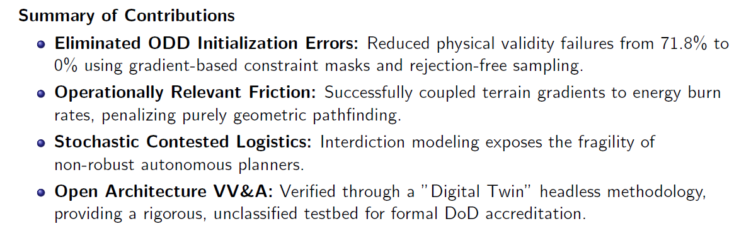
Conclusion
Notes:
In conclusion, we successfully eliminated initialization errors by using gradient-based constraint masks. We introduced operationally relevant friction by coupling terrain gradients to energy burn rates. We exposed the fragility of non-robust planners through stochastic logistics modeling. Finally, we verified the entire system through an open-architecture, headless methodology, providing a rigorous testbed suitable for formal DoD accreditation.

Slide 21
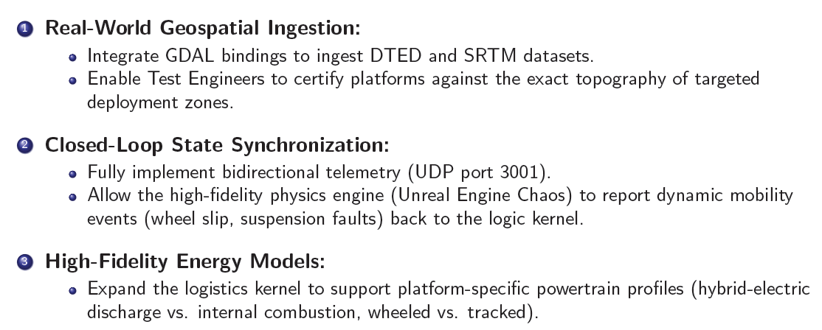
Future Work
Notes:
Our immediate next step is real-world geospatial ingestion. We will integrate standard bindings to ingest DTED and SRTM datasets so engineers can test against exact deployment topography. We will also fully implement bidirectional telemetry. This will allow the high-fidelity physics engine to report dynamic mobility events, like wheel slip, back to our logic kernel. Finally, we plan to expand our energy models to support specific powertrain profiles, comparing hybrid-electric discharge against internal combustion.

Slide 22

Acknowledgments & Questions
Notes:
We would like to acknowledge the technical and financial support of the Automotive Research Center in accordance with our cooperative agreement with the U.S. Army DEVCOM Ground Vehicle Systems Center. Thank you for your time. I am happy to take any questions.

